Slide 1
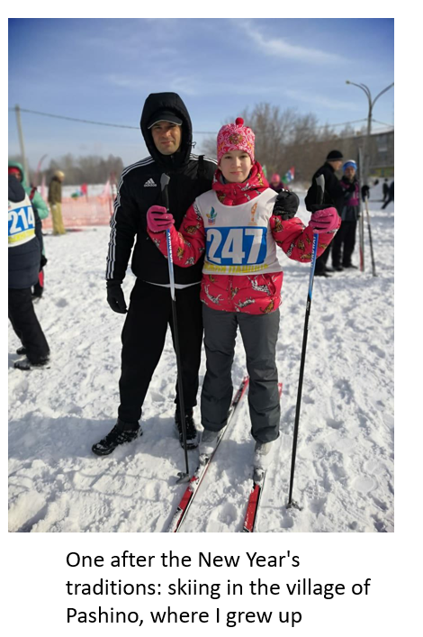
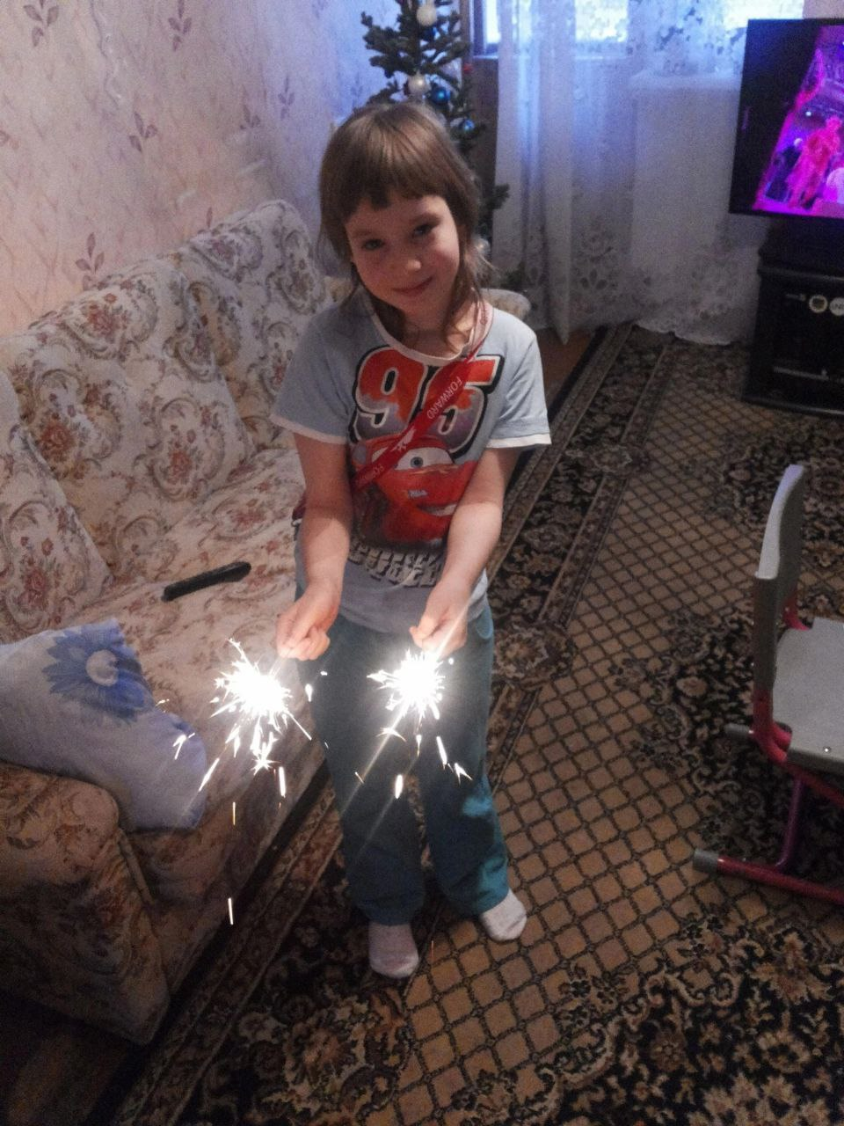
In my family, we gather for a big dinner on New Year's Eve and share our resolutions for the upcoming year. This tradition occurs every December 31st at my grandmother's house, the central gathering place for our family. All my close relatives, including parents, cousins, and grandparents, participate. The tradition started because my grandparents wanted to celebrate the New Year in a special way. As a child, I used to run and play a lot on New Year's Eve, and as a teenager, I read books under the Christmas tree. Now, we focus on sharing resolutions and reflecting on the past year. I enjoy this tradition as it allows us to reconnect and share our hopes for the future, and I believe it will continue for generations to come.

